Slide 1
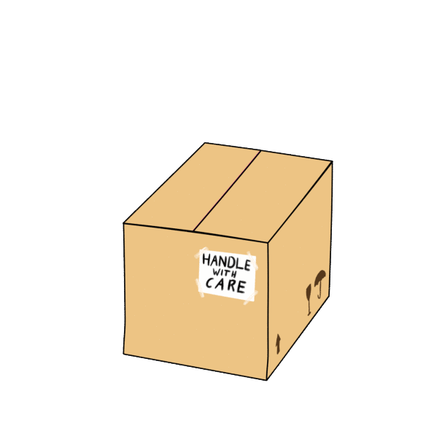
Take a guess.
What is it?

Slide 2
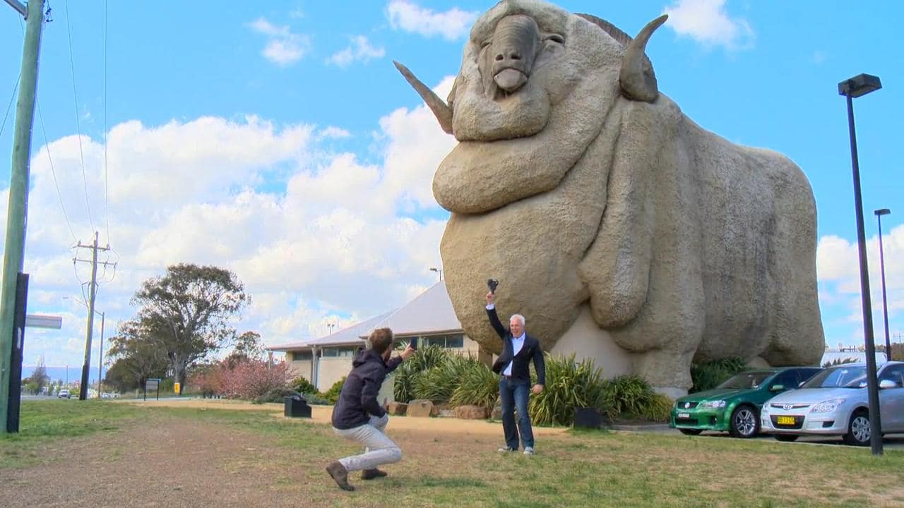
big

Slide 3
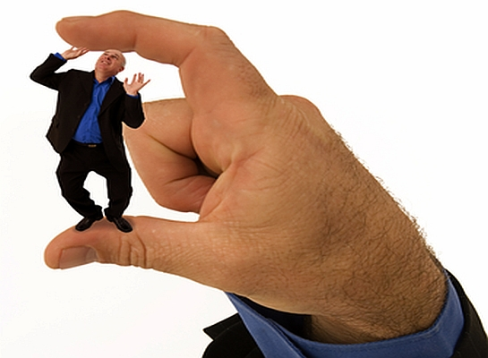
small

Slide 4
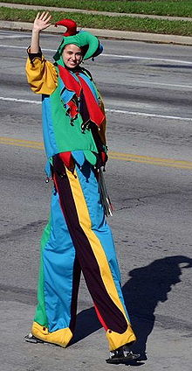
tall

Slide 5
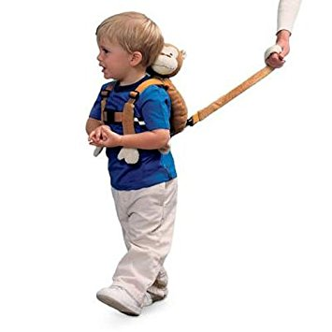
short

Slide 6
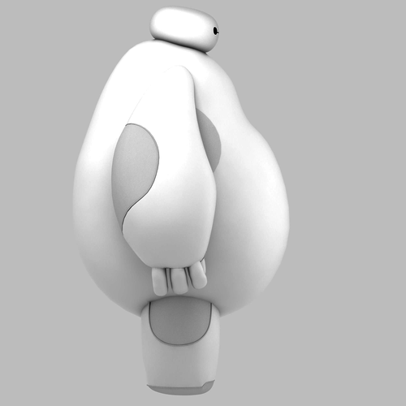
fat

Slide 7
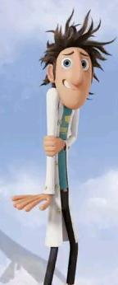
thin

Slide 8
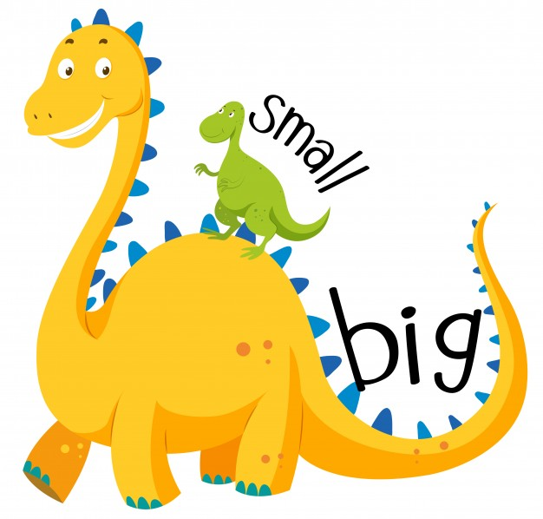
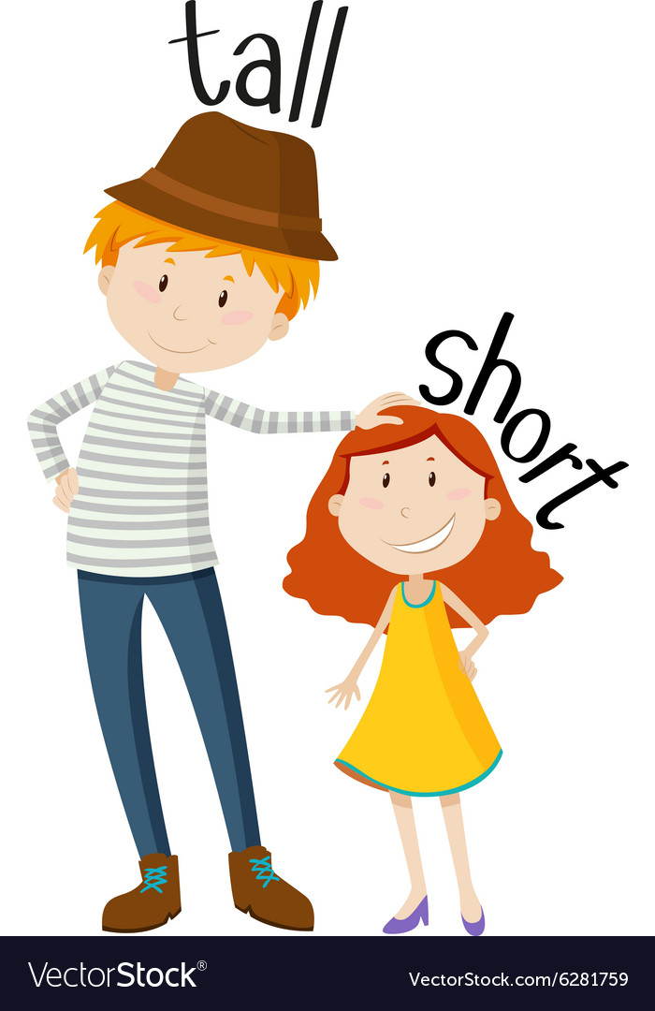
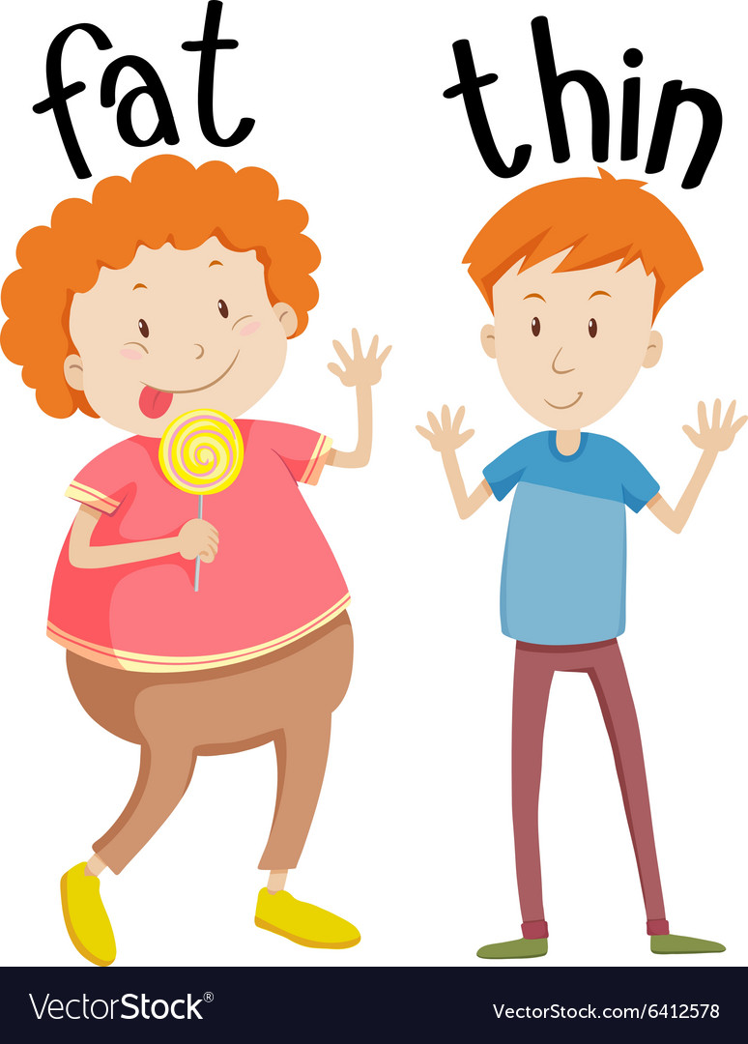

Slide 9
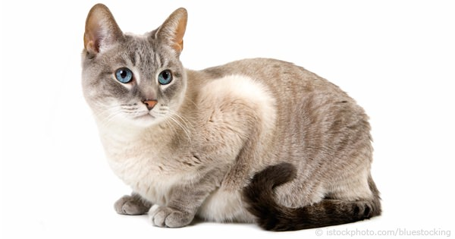
cat

Slide 10
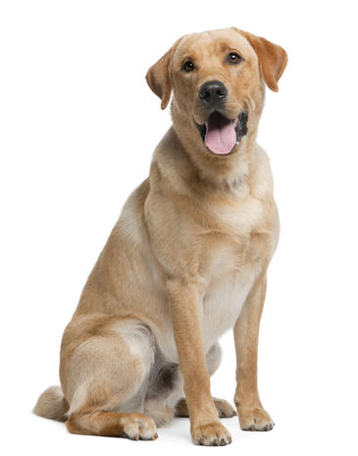
dog

Slide 11
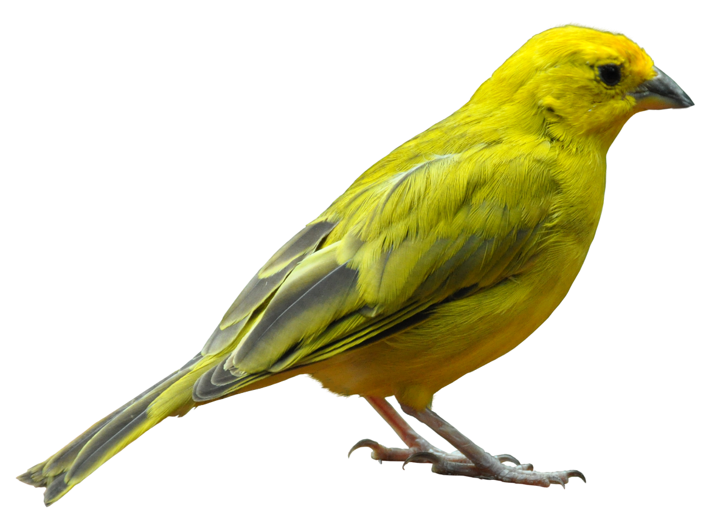
bird

Slide 12
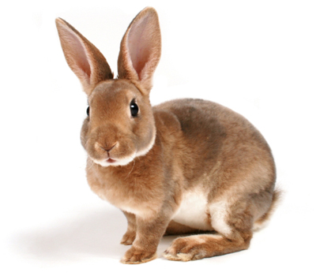
rabbit

Slide 13
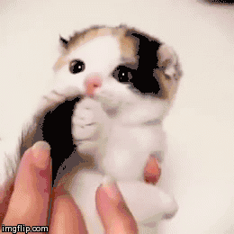
It is a cat.
It is a small cat.

Slide 14
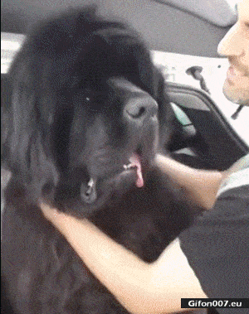
It is a dog.
It is a big dog.

Slide 15
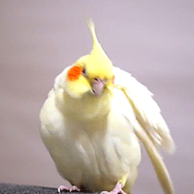
It is a bird.
It is a fat bird.

Slide 16
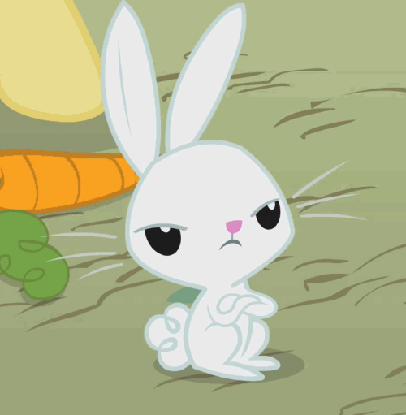
It is a rabbit.
It is a thin rabbit.

Slide 17
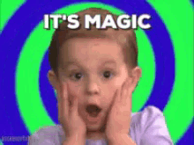
要變成疑問句囉!!
把 is移到最前面，
i變成大寫I，句子最後加上?

Slide 18
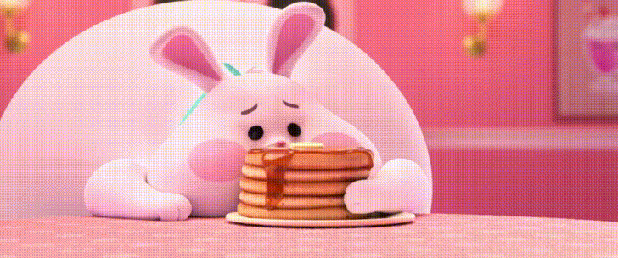
Is it a rabbit?

Slide 19
Yes, it is.
No, it isn’t.

Slide 20
Is is a fat rabbit?

Slide 21
Yes, it is.
No, it isn’t.

Slide 22
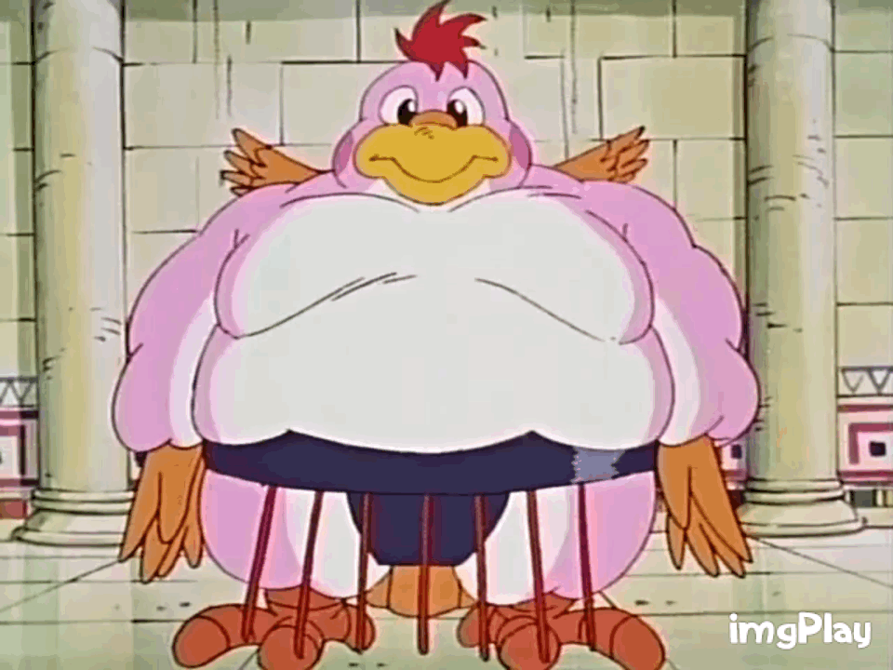
Is it a bird?

Slide 23
Yes, it is.
No, it isn’t.

Slide 24
Is it a small bird?

Slide 25
Yes, it is.
No, it isn’t.

Slide 26
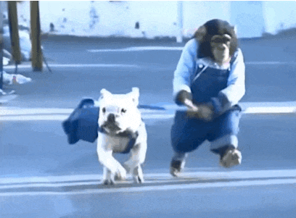
Is it a cat?

Slide 27
Yes, it is.
No, it isn’t.

Slide 28
Is it a big dog?

Slide 29
Yes, it is.
No, it isn’t.

Slide 30
Attention!!!
isn’t = is not.
It is not.= It isn’t. 或是 It’s not.
Yes, it is.中的it is
不可以縮寫。

Slide 34
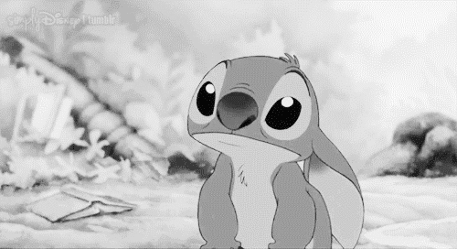

Slide 35
主人
路邊

Slide 36
